Slide 1
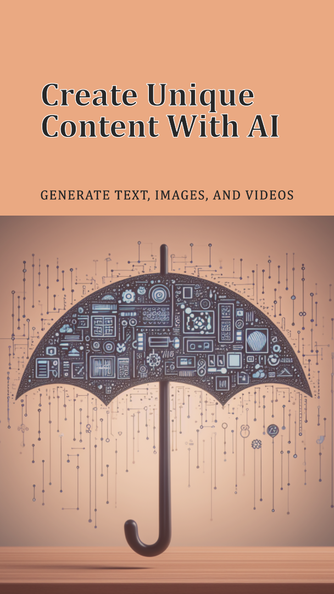
Generative AI
AI encompasses a broad range of content generation techniques, Large Language Models (LLM) are a specific application of Generative AI that serves as foundation models, providing a basis for a wide spectrum of natural language processing (NLP) tasks.
Generative AI is an umbrella term for algorithms capable of producing content like text, images, and videos.
The relationship between Generative AI and LLMs is that LLMs are a specific type of Generative AI focused on natural language processing tasks.

Slide 2
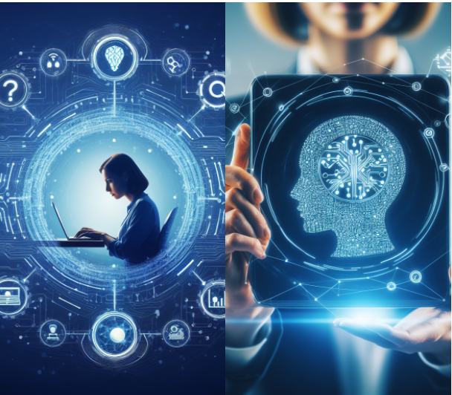
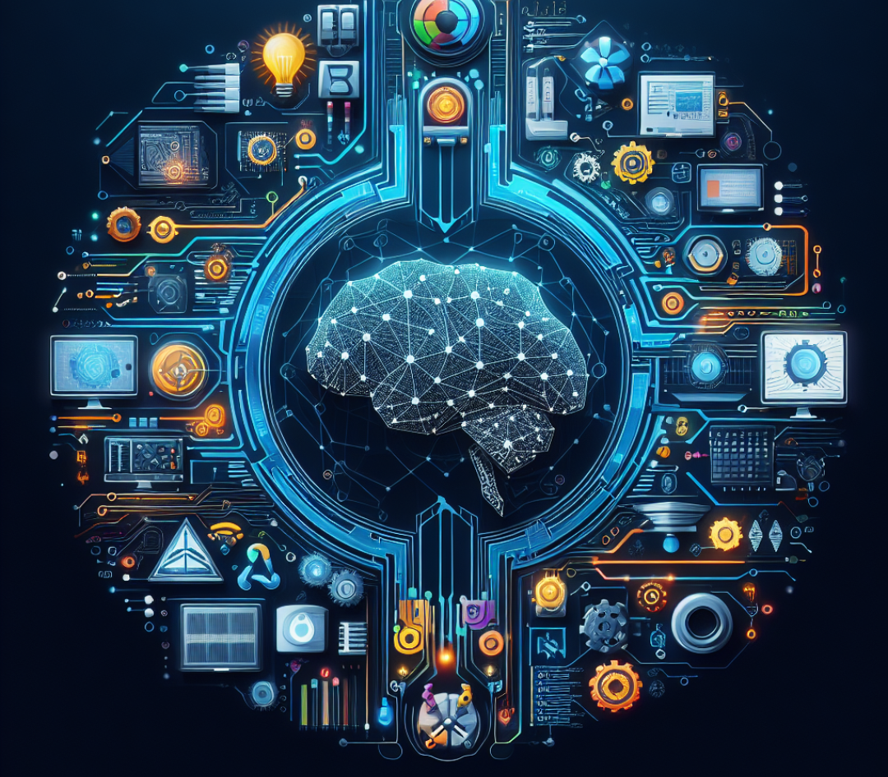
Artificial Intelligence (AI) is deeply intertwined with Information Technology (IT). “IT” provides the infrastructure and tools necessary for developing and deploying AI systems. Conversely, “AI” can be used to enhance “IT” systems by automating tasks, optimizing processes, and enabling better decision-making.

Slide 3
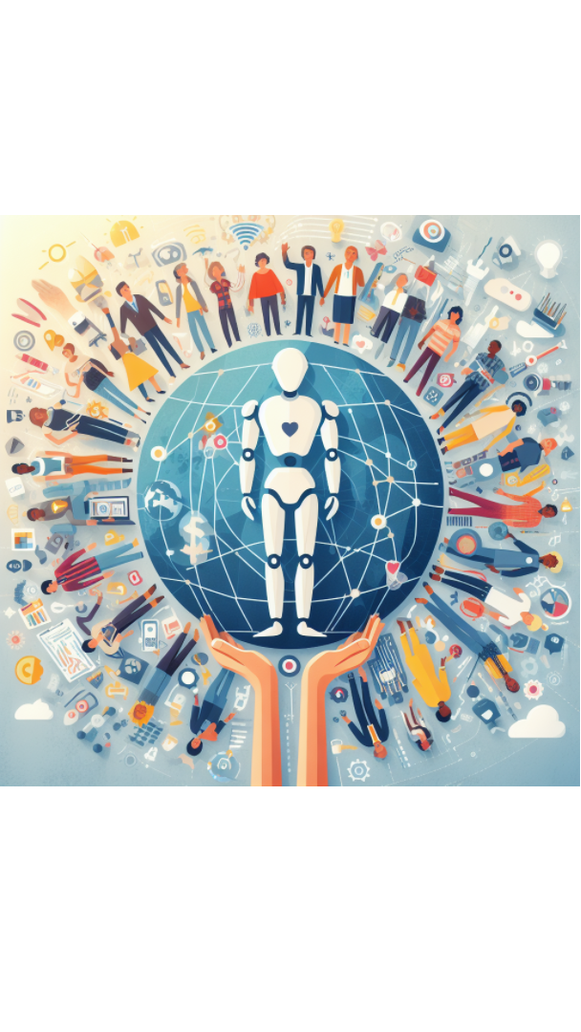
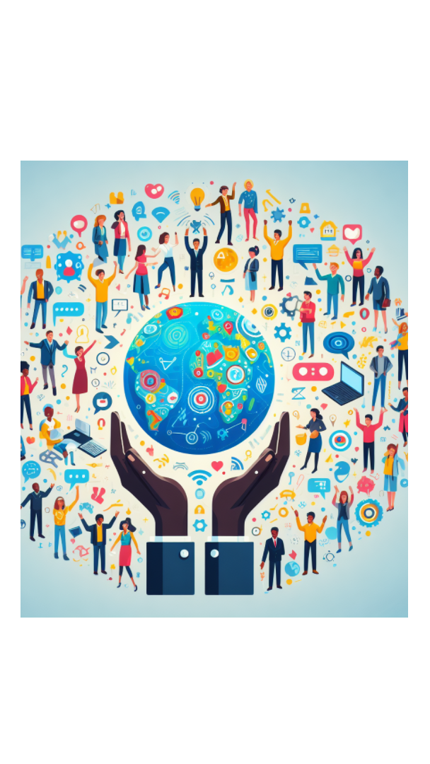
AI for Good: Steering Technology for Humanity’s Benefit
We must harness Artificial Intelligence's power responsibly, ensuring it is used for the betterment of humanity.

